Slide 1
Chapter 6 (Decision Logic structure )
Nida Munawar

Slide 2
Decision structure
Selection Statements : Ask a question which path to take next.
three types of selection structures in the form of statements.
The if selection statement either selects (performs) an action if a condition is true or skips the action if the condition is false. (single-selection statement )
The if…else selection statement performs an action if a condition is true and performs a different action if the condition is false. (double-selection statement )
The switch selection statement performs one of many different actions, depending on the value of an expression. (multiple-selection statement because it selects among many different actions)

Slide 3

Problem:
The Fantastic Floral Company sells to wholesale and retail buyers. The wholesale
buyer needs a resale number in order to buy at no tax and to receive discounts. The retail
buyer pays 6% tax. These are the discounts to the wholesale buyer:
Given an amount of purchase, how much will the customer owe the company?

Slide 4
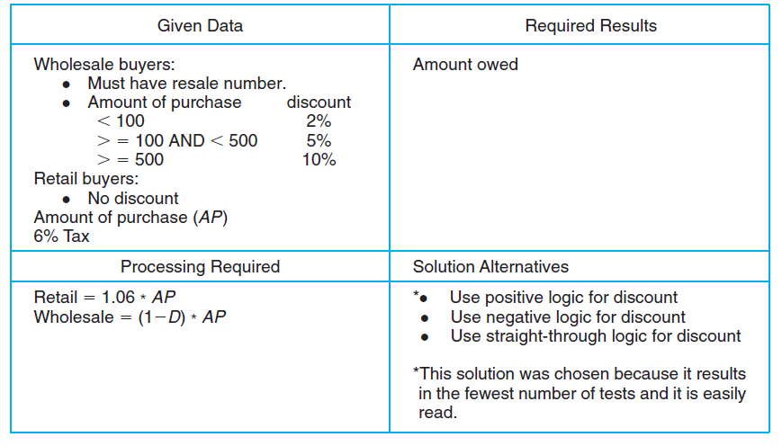
PAC:

Slide 5
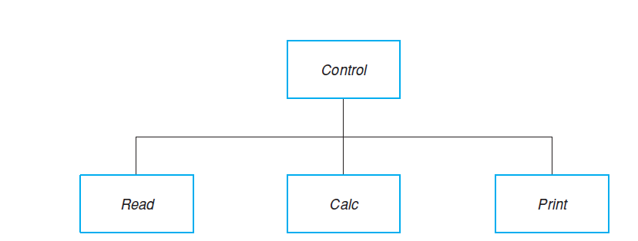
HIPO:

Slide 6
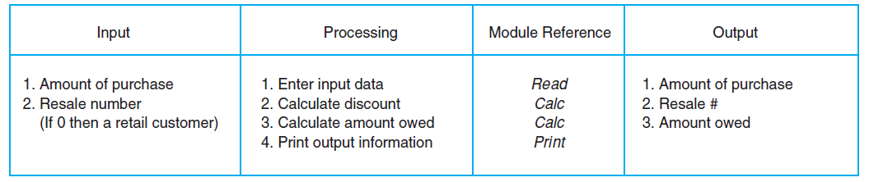
IPO:

Slide 7
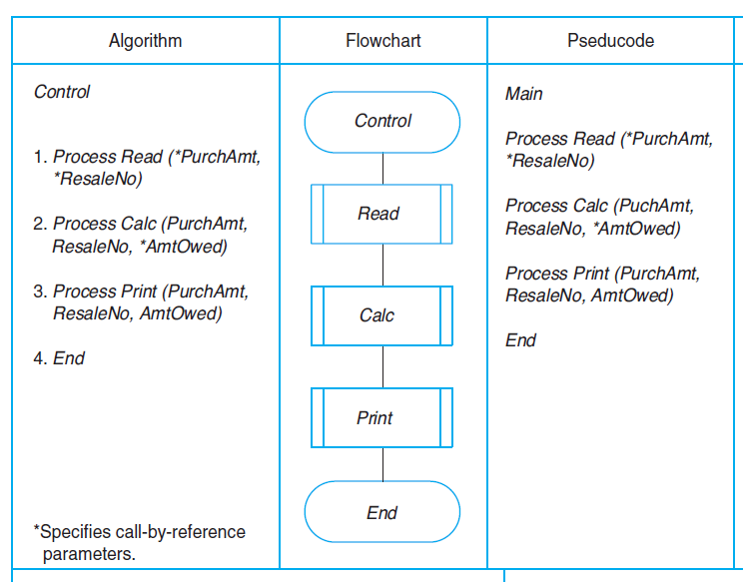
The Algorithms and Flowcharts—Control Module

Slide 8
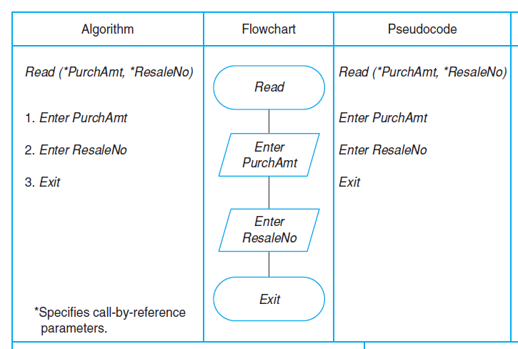
Read Module

Slide 9
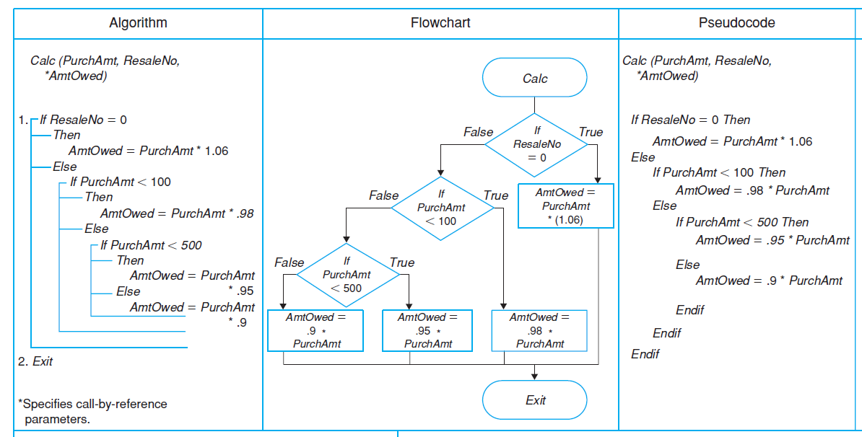
CAL Module:

Slide 10
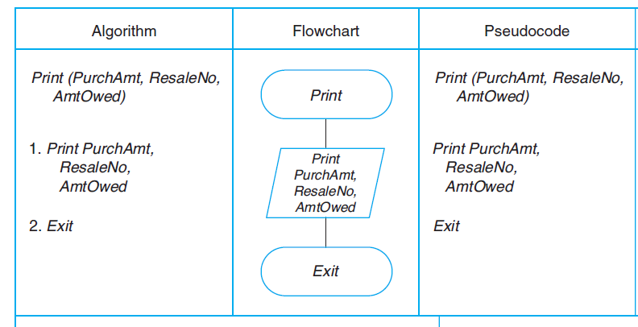
Print Module:

